Slide 1
Data Filtering & Smoothing
Object Oriented Programming
“
Outliers are not necessarily a bad thing, they can be the starting point for new discoveries.
”
- John Tukey

Slide 2
Contents:
Meet our Team
Introduction
Data Flow
Outlier Recognition
Interpolation
Smoothing
Summary
References

Slide 3



Meet the Team
Rohit Arunachalam Gopinath
Outlier Recognition
Muhammad Munam Uddin Farooqui
Interpolation
Eduardo Guandulain
Juarez
Smoothing

Slide 4
Introduction – Data Filtering
Remove or reduce noise from a signal or dataset.
Used in signal processing, image processing, and data analysis.
Why Data Filtering?
Improve the quality of data
Notes:
Data filtering is a technique used to remove or reduce noise from a signal or dataset by selecting certain values or patterns while discarding others. It is commonly used in signal processing, image processing, and data analysis to improve the quality of data.

Slide 5
Data Flow
Outlier Recognization
Z-Score
Interpolation
Forward Fill Interpolation
Smoothing
Savitzky-Golay
Linear Interpolation
Cubic Interpolation
Spline Interpolation
Modified Z-Score
Isolation Forest
Inter-Quantile Range
Moving Average
Exponential
Manipulated
Data for ML
and AI
Data from the User

Slide 6
OUTLIER RECOGNITION
Data Filtering

Slide 7
Outlier Recognition
Overview:
Reason:
Data points or observations that are significantly different from other data points in a dataset
An observation that lies an abnormal distance from other values in a random sample.
Measurement Errors
Data Processing Errors
Unusual or rare events in the data.
Notes:
Outlier recognition is the process of identifying data points or observations that are significantly different from other data points in a dataset
An outlier is an observation that lies an abnormal distance from other values in a random sample.
Outliers can occur due to measurement errors, data processing errors, or they may represent unusual or rare events in the data.

Slide 8
Classification
Global Outlier:
Local Outlier:
Significantly different from the rest of the dataset.
Significant impact on the overall results of data analysis.
Significantly different from the surrounding data point
Less impact on the overall results of data analysis
Notes:
Global Outlier AKA Universal Outlier.
The error data lies extremely far

Slide 9
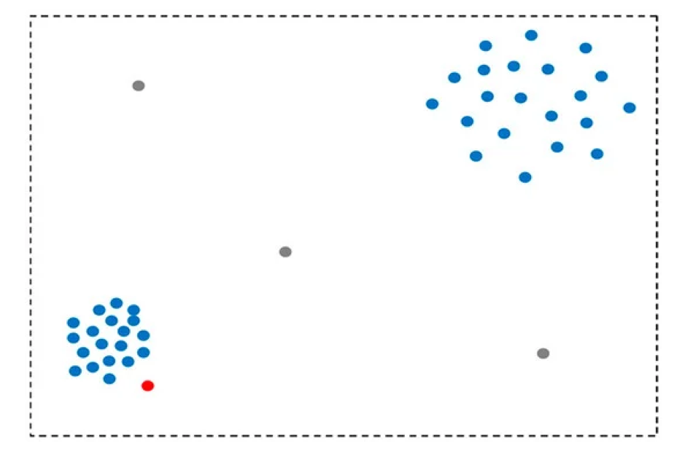

Slide 10
Methods
Z-Score
Mathematic / Statistic Technique
Mathematic / Statistic Technique
Modified Z-Score
Mathematic / Statistic Technique
Inter- Quantile Range
Isolation Forest
Machine Learning Technique
1
2
3
4

Slide 11
Method – 1: Z-Score
How many standard deviations a value is away from the mean of the dataset.
Z = (xi - μx)/σx, where
xi– Observation / Data Set Value
μx – Mean
σx – Standard Deviation,
Z Score =0 – Data Point = Mean
Z Score +Ve – Data Point above Mean
Z Score –Ve – Data Point below Mean

Slide 12
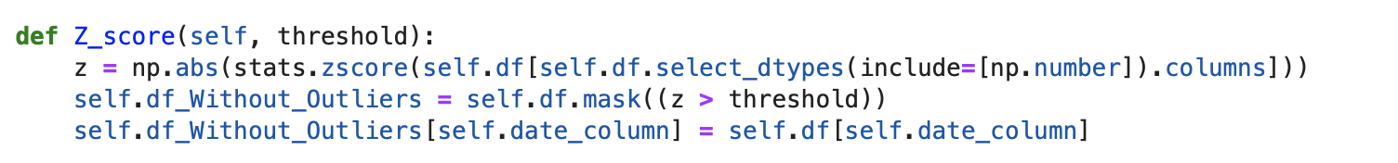
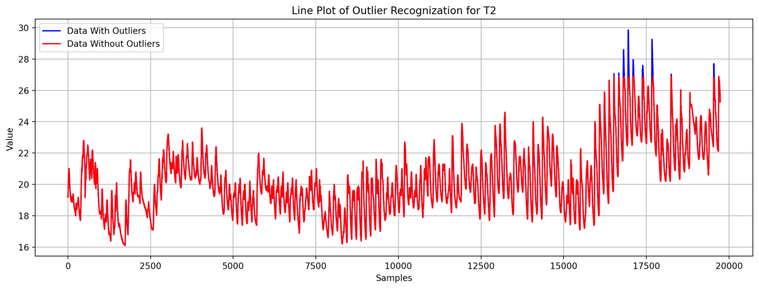
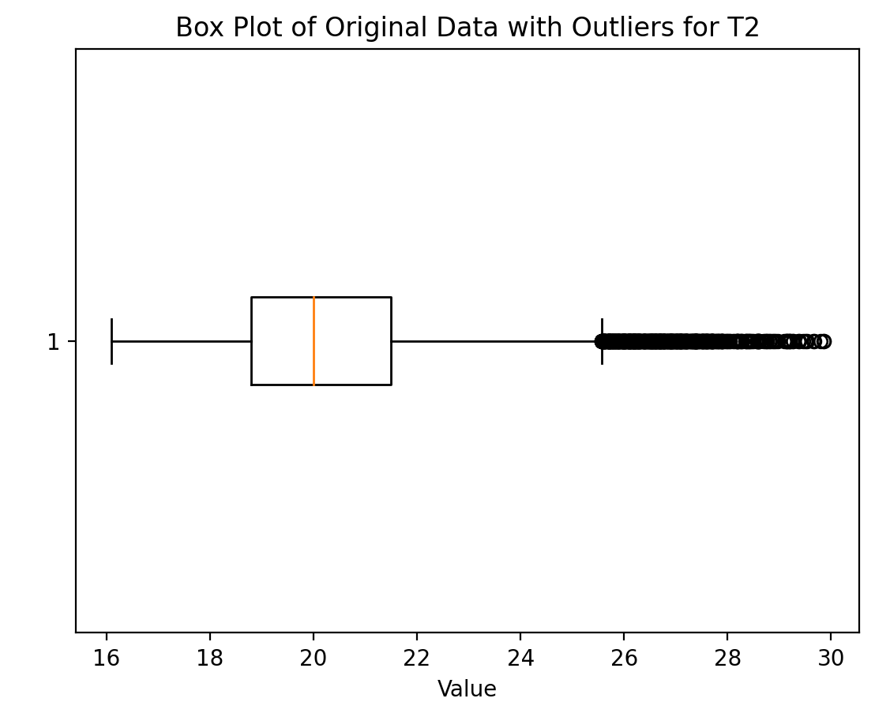
Code
Notes:
Identifies outliers by setting a threshold
uses the numpy library to calculate the absolute Z-score for each numeric column of the dataset - np.abs(stats.zscore())
If the Z-score for a data point in a column is greater than the specified threshold, it is considered an outlier.
The self.df.mask((z > threshold)) function replaces the outliers in the dataset with NaN (Not a Number) values. This means that the data points marked as outliers are removed from the dataset.
The date column is copied to the new dataset without outliers to ensure that the time series order is not affected by the outlier removal

Slide 13
Advantages and Limitations
Easy to understand and apply.
It is a standardized method that can be used across different datasets.
Assumes that the data is normally distributed, which may not always be the case.
The z-score method may not be effective for datasets with a small sample size or datasets with extreme outliers.

Slide 14
Method – 2: Modified Z-Score
How many median absolute deviations (MAD) a data point is from the median of the data set
modified z = 0.6745 * (xi - median) / MAD, where
xi– Observation / Data Set Value
median – Median
MAD – Median Absolute Deviation.
Notes:
remove outliers from a dataset that takes into account the median and median absolute deviation (MAD) instead of the mean and standard deviation.

Slide 15
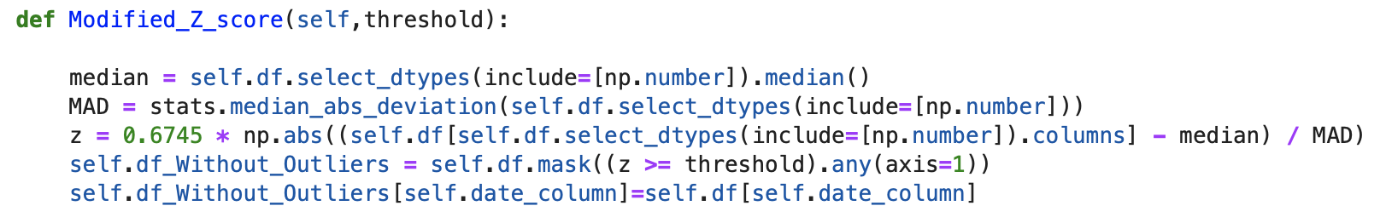
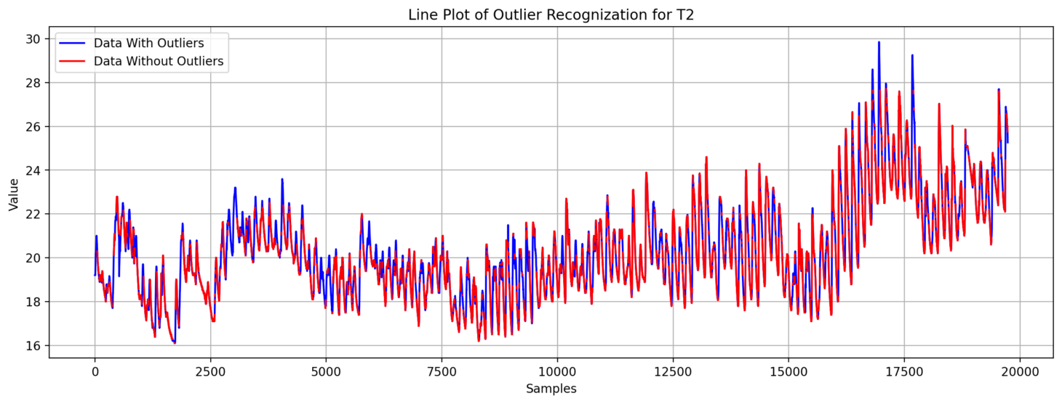
Code
Notes:
Identifies outliers by setting a threshold
For how many median absolute deviations a data point can deviate from the median before being considered an outlier.
A common threshold is a modified z-score of 3.5, meaning that any data point with a modified z-score greater than 3.5 or less than –3.5 is considered an outlier.
The modified z-score method can also be used to identify mild outliers with a modified z-score between 2 and 3.5.

Slide 16
Advantages and Limitations
The modified z-score method is robust to outliers and is not affected by extreme values.
It is a standardized method that can be used across different datasets.
The modified z-score method assumes that the data is symmetrically distributed, which may not always be the case.
The modified z-score method may not be effective for datasets with a small sample size or datasets with a large number of mild outliers.

Slide 17
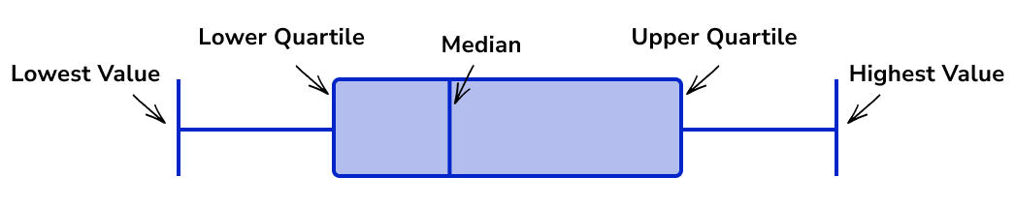
Method – 3: Inter-Quantile Range
Measure of the spread of the middle 50% of a dataset, or the range between the 25th and 75th percentiles.
IQR = Q3 - Q1, where
Q3 – is the 75th percentile
Q1 – is the 25th percentile
Lower bound = Q1 - 1.5 * IQR
Upper bound = Q3 + 1.5 * IQR
IQR represents the range of values that contain the majority of the data, and any data points outside this range can be considered potential outliers
Notes:
The IQR is a measure of the spread of the middle 50% of a dataset, or the range between the 25th and 75th percentiles.
It is represented by the formula: IQR = Q3 - Q1, where Q3 is the 75th percentile and Q1 is the 25th percentile.
The IQR represents the range of values that contain the majority of the data, and any data points outside this range can be considered potential outliers.

Slide 18
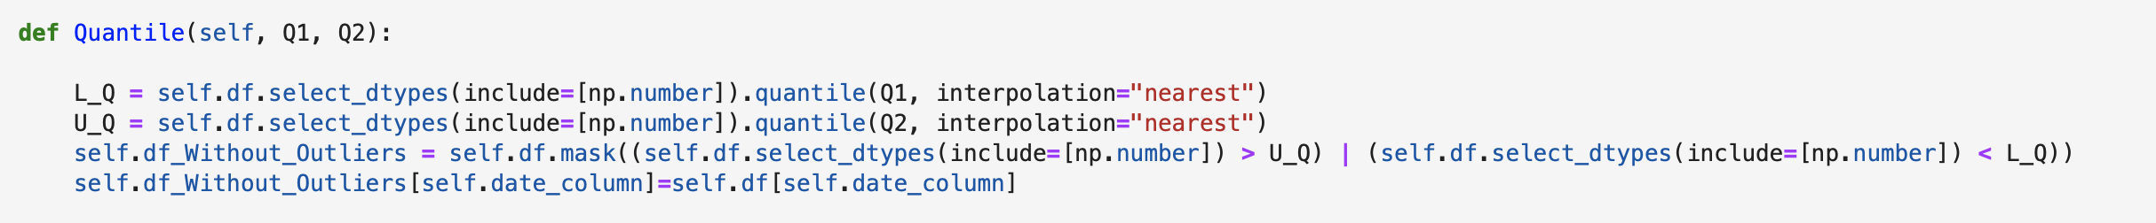
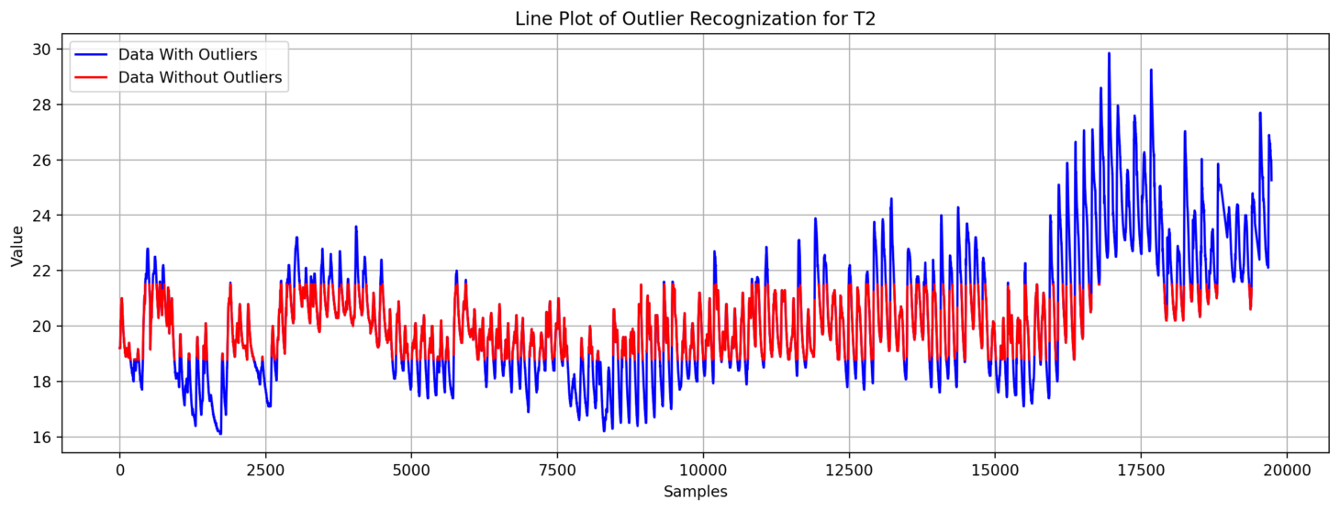
Code
Notes:
The IQR method identifies outliers by setting a threshold for how many IQRs a data point can deviate from the median before being considered an outlier.
A common threshold is 1.5 times the IQR, meaning that any data point below Q1 - 1.5 * IQR or above Q3 + 1.5 * IQR is considered an outlier.
The IQR method can also be used to identify mild outliers with a threshold of 3 times the IQR.

Slide 19
Advantages and Limitations
The IQR method is a robust method that is not affected by extreme values.
It is a standardized method that can be used across different datasets.
The IQR method assumes that the data is symmetrically distributed, which may not always be the case.
The IQR method may not be effective for datasets with a small sample size or datasets with a large number of mild outliers.
Notes:
The IQR method identifies outliers by setting a threshold for how many IQRs a data point can deviate from the median before being considered an outlier.
A common threshold is 1.5 times the IQR, meaning that any data point below Q1 - 1.5 * IQR or above Q3 + 1.5 * IQR is considered an outlier.
The IQR method can also be used to identify mild outliers with a threshold of 3 times the IQR.

Slide 20
Method – 4: Isolation Forest
Unsupervised machine learning algorithm for outlier detection.
It works by randomly selecting a feature and a split value to partition the data recursively into smaller subsets
The algorithm continues this process until the anomalous data points are isolated into small subsets.
s(x)=2 Pow{−E[h(x)] / c(n)},where
E[h(x)] - Average path length over all isolation trees of data x
c(n) - Average path length of all data set
n - Number of external nodes
Notes:
Isolation Forest is an unsupervised machine learning algorithm for outlier detection.
It is based on the principle of isolating anomalies instead of trying to model normal data points.
It works by randomly selecting a feature and a split value to partition the data recursively into smaller subsets.
The algorithm continues this process until the anomalous data points are isolated into small subsets.

Slide 21
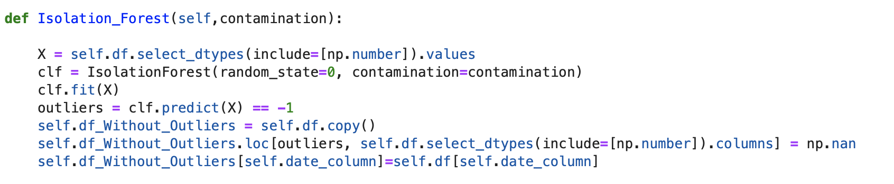
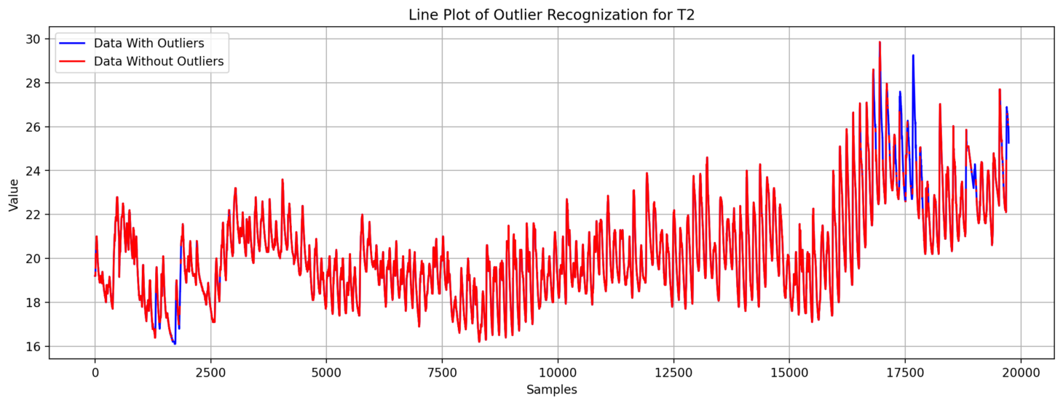
Code
Notes:
The algorithm works by creating a forest of isolation trees.
Which data point is quickly isolated & which data point has a short path length
Each isolation tree is constructed by randomly selecting a feature and a split value to partition the data.
The number of splits required to isolate a data point is used as a measure of its abnormality.
Data points that require fewer splits to isolate are considered more anomalous.

Slide 22
Advantages and Limitations
Simple to implement and computationally efficient
Large datasets with a high dimensionality
Not suitable for detecting outliers in datasets with a low percentage of anomalies
Produce false positives when the dataset contains clusters of anomalies.
Notes:
Isolation Forest is simple to implement and computationally efficient.
It can handle large datasets with a high dimensionality.
It is insensitive to the scale of the data and can detect outliers in both dense and sparse regions.
Isolation Forest is not suitable for detecting outliers in datasets with a low percentage of anomalies.
It may produce false positives when the dataset contains clusters of anomalies.
The algorithm may not work well when the data is highly correlated.

Slide 23
INTERPOLATION
Data Filtering

Slide 24
Interpolation
Overview:
Interpolation is a method of estimating values between known data points.
It is important in time series data after outlier detection because it can help to fill in missing values and provide a more complete and accurate representation of the data
The goal of interpolation is to estimate a value that is consistent with the known data.
It is often used in scientific, engineering, and mathematical applications where data is incomplete or missing.

Slide 25
Methods
Forward Fill Interpolation
Cubic Interpolation
Spline Interpolation
Linear Interpolation
1
2
3
4

Slide 26
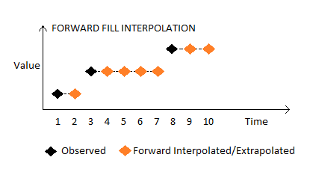
Method – 1: Forward Fill Interpolation
Forward fill is a method of interpolation that uses the last known value to fill in missing values.
It is often used in time series data where missing values are replaced with the previous known value.

Slide 27
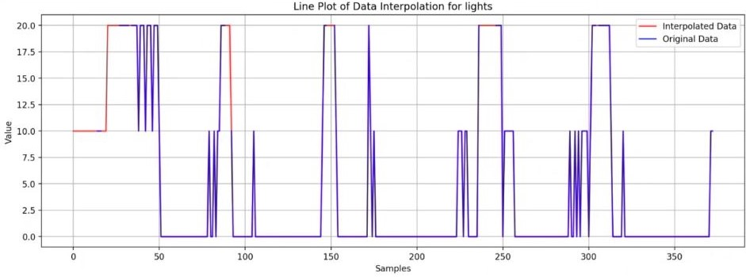
Implementation in Python
def ffill(self):
self.interpolated_df = self.df.copy()
self.interpolated_df = self.interpolated_df.ffill()

Slide 28
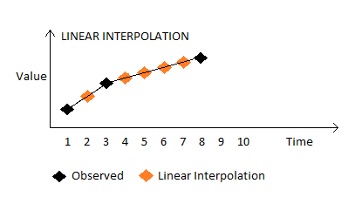
Method – 2: Linear Interpolation
Linear interpolation is a method that uses a straight line to estimate values between two known points.
It assumes a constant rate of change between the two points.

Slide 29
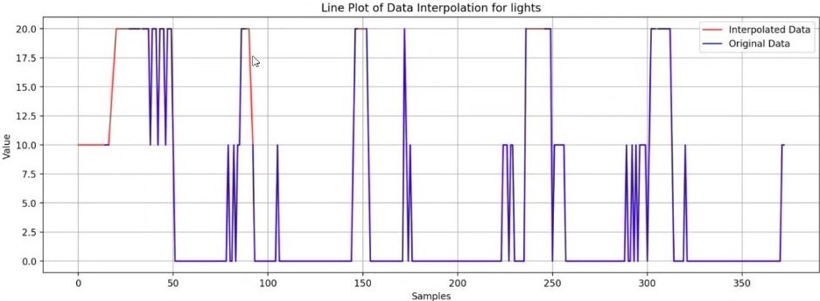
Implementation in Python
def linear(self):
num_cols = self.df.select_dtypes(include=[np.number]).columns
self.interpolated_df = self.df.copy()
self.interpolated_df[num_cols] = self.interpolated_df[num_cols].interpolate(method='linear',
limit_direction='both')

Slide 30
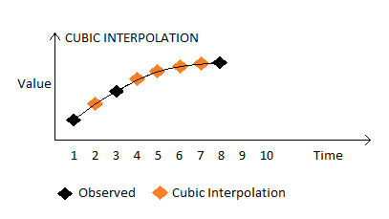
Method – 3: Cubic Interpolation
Cubic interpolation is a method that uses a cubic polynomial to estimate values between known points.
It provides a smoother estimate than linear interpolation.

Slide 31
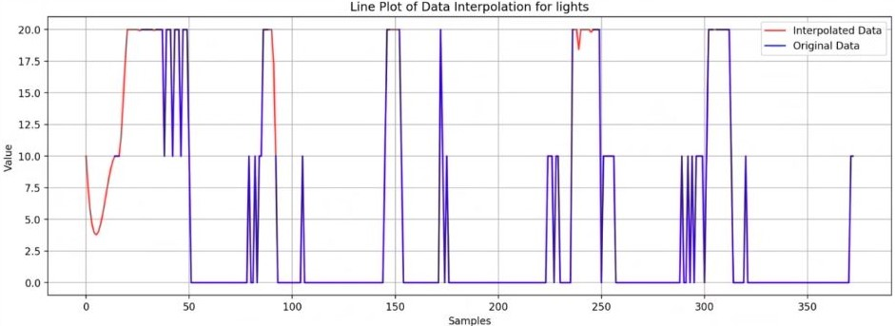
Implementation in Python
def cubic(self):
num_cols = self.df.select_dtypes(include=[np.number]).columns
self.interpolated_df = self.df.copy()
self.interpolated_df[num_cols] = self.interpolated_df[num_cols].interpolate(method='cubic',
limit_direction='both')

Slide 32
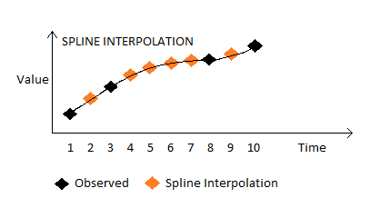
Method – 4: Spline Interpolation
Spline interpolation is a method that uses piecewise polynomial functions to estimate values between known points.
It provides a smooth and flexible estimate.
It can handle data with complex shapes and irregularities.

Slide 33
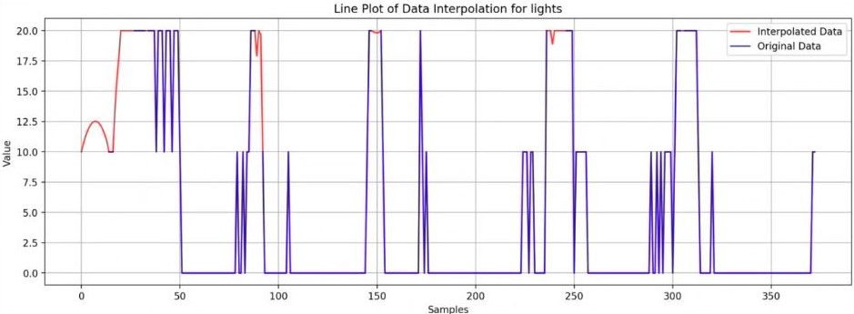
Implementation in Python
def spline(self):
num_cols = self.df.select_dtypes(include=[np.number]).columns
self.interpolated_df = self.df.copy()
self.interpolated_df[num_cols] = self.interpolated_df[num_cols].interpolate(method='spline',
order= self.order, limit_direction='both')

Slide 34
Challenges
NULL Values in the first and/or last value
Outliers after Interpolation in Data

Slide 35
SMOOTHNING

Slide 36
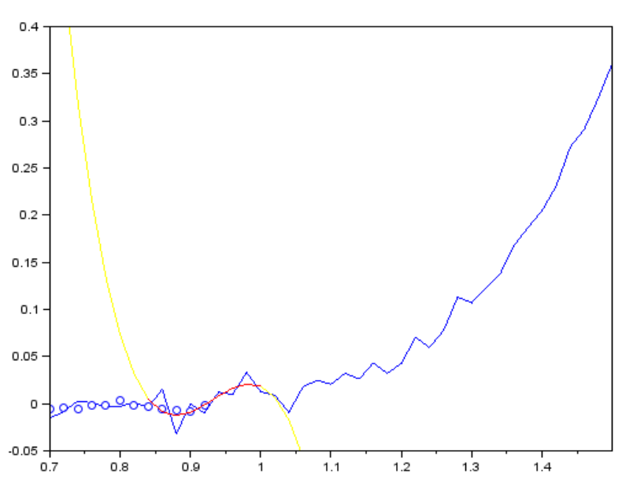
Savitzky-Golay Filter
It works by fitting a polynomial function to a small window of data points and using that polynomial to estimate the value of the central point in the window.
[1]

Slide 37
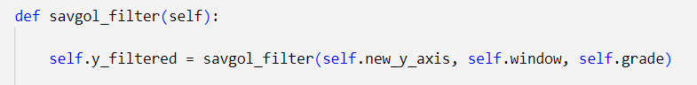
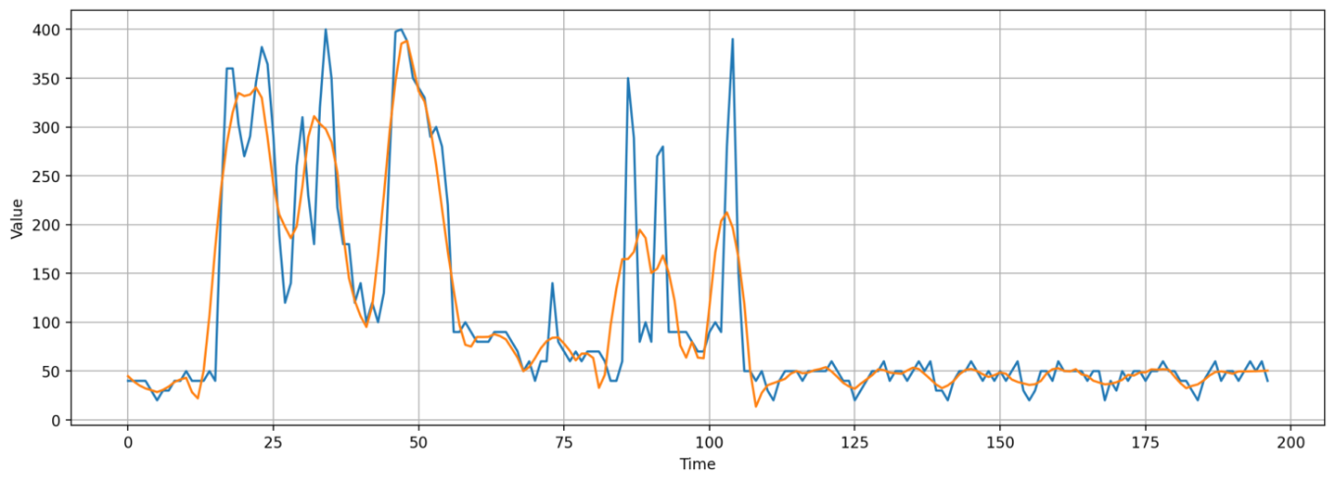
Implementation in Python

Slide 38
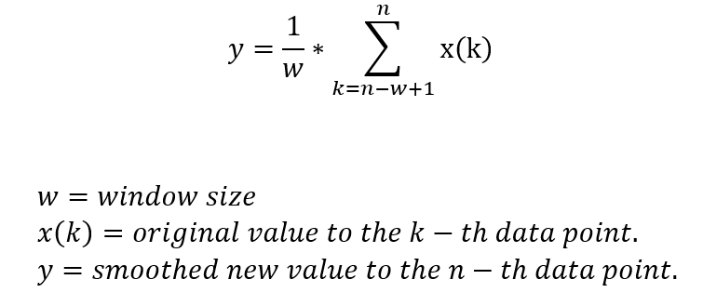
Moving Average
It works by replacing each data point with the average value of its neighboring points within a window of a fixed size.

Slide 39
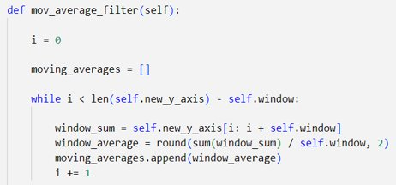
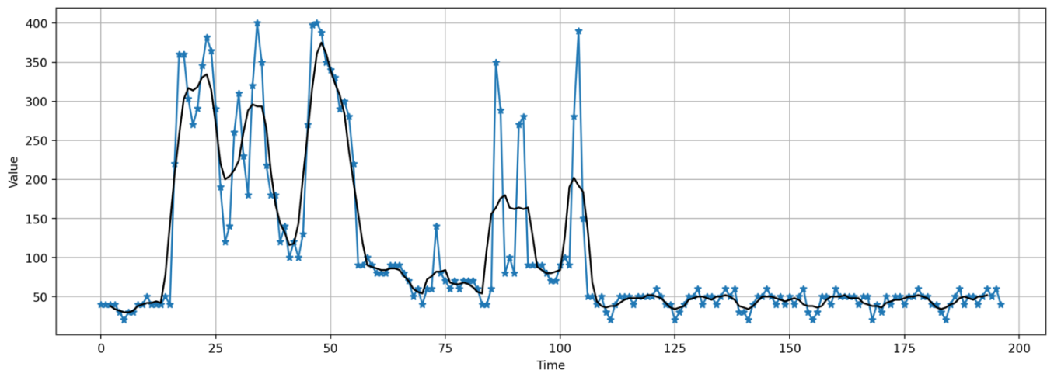
Implementation in Python

Slide 40
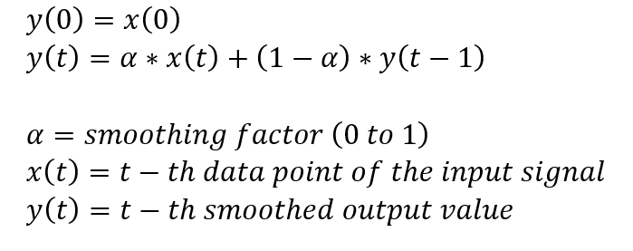
Exponential Filter
Reduces noise in a signal by applying a weighted average of past and current data points. The weights assigned to each data point decrease exponentially as the data gets older

Slide 41
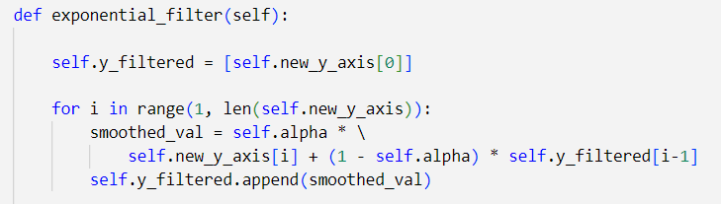
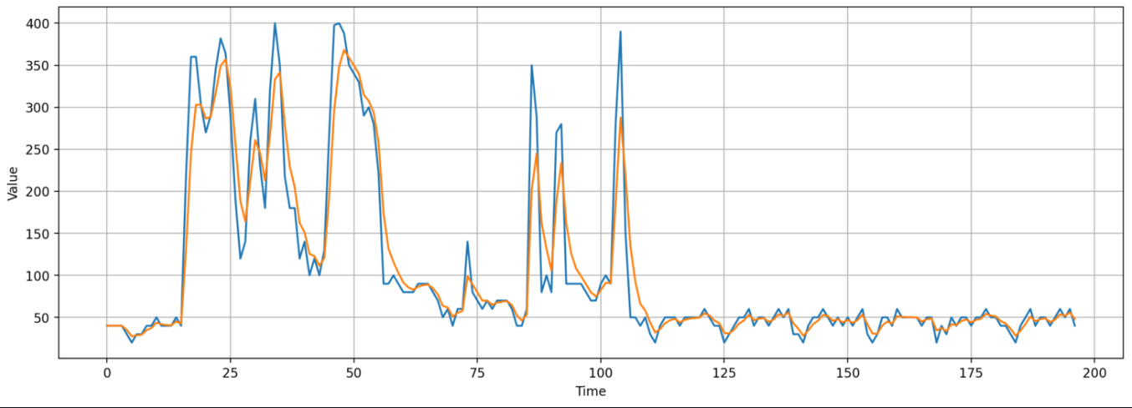
Implementation in Python

Slide 42
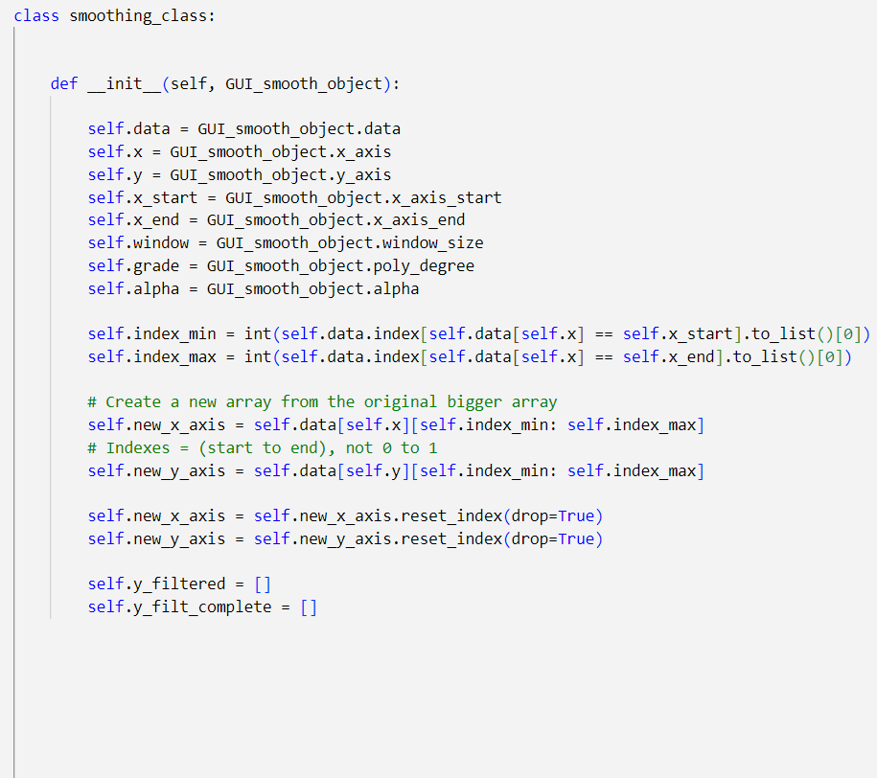
Class Definition

Slide 43
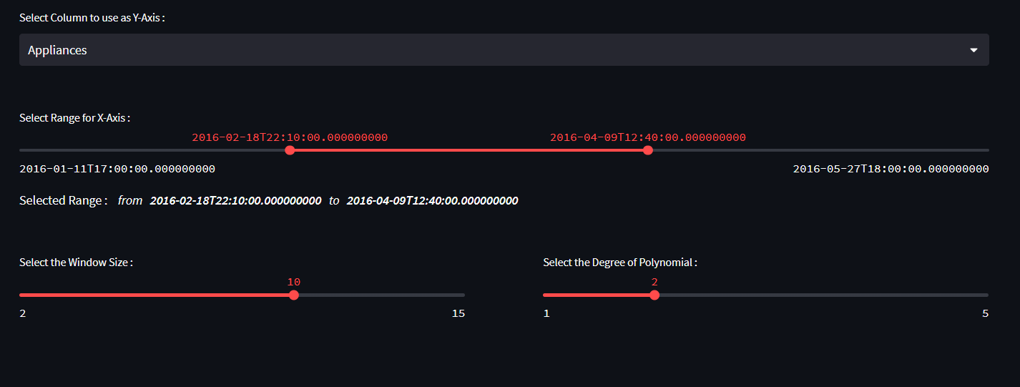
User Interface

Slide 44
Challenges
Savitzky-Golay
Moving Average
Can introduce lag or phase shift in the signal due to the time delay caused by the moving window
Exponential
The smoothing factor alpha needs to be carefully selected based on the characteristics of the signal and the desired level of smoothing
Can introduce artifacts or distortions in the signal if the window size is too small or the polynomial degree is too high

Slide 45
Summary
We have performed outlier removal, interpolation, and smoothing on a time series data frame. The outliers were identified and removed using an appropriate method. The missing values were interpolated using a suitable technique, and the resulting data was smoothened to reduce noise and improve readability. The resulting dataset is now more suitable for further analysis and modeling, as it provides a more accurate representation of the underlying patterns in the data.

Slide 46
References
[1]https://en.wikipedia.org/wiki/Savitzky%E2%80%93Golay_filter#/media/File:Lissage_sg3_anim.gif

Slide 47
sd
Thank You

